Slide 1
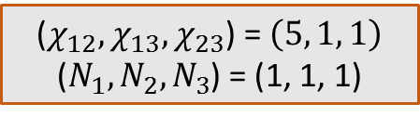
($χ_{12}, χ_{13}, χ_{23}$) = $\left(5, 1, 1\right)$
($N_{1}, N_{2}, N_{3}$) = (1, 1, 1)
Binodal line plotted by using 30 degree Taylor Series | Binodal line plotted by using exact logarithmic terms

Slide 2
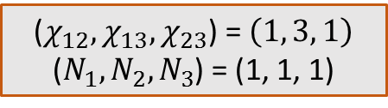
($χ_{12}, χ_{13}, χ_{23}$) = $\left(1, 3, 1\right)$
($N_{1}, N_{2}, N_{3}$) = (1, 1, 1)
Binodal line plotted by using 30 degree Taylor Series | Binodal line plotted by using exact logarithmic terms
Note: Number of obtained solutions for bimodal curve can be
increased if I run the code on a parallel machine.

Slide 3
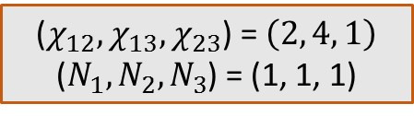
($χ_{12}, χ_{13}, χ_{23}$) = $\left(2, 4, 1\right)$
($N_{1}, N_{2}, N_{3}$) = (1, 1, 1)
Binodal line plotted by using 30 degree Taylor Series | Binodal line plotted by using exact logarithmic terms
Note: Number of obtained solutions for bimodal curve can be
increased if I run the code on a parallel machine.

Slide 4
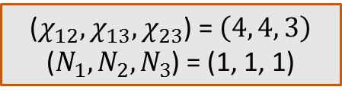
($χ_{12}, χ_{13}, χ_{23}$) = $\left(4, 4, 3\right)$
($N_{1}, N_{2}, N_{3}$) = (1, 1, 1)
Binodal line plotted by using 30 degree Taylor Series | Binodal line plotted by using exact logarithmic terms

Slide 5

($χ_{12}, χ_{13}, χ_{23}$) = $\left(2, 4, 3\right)$
($N_{1}, N_{2}, N_{3}$) = (1, 1, 1)
Binodal line plotted by using 30 degree Taylor Series | Binodal line plotted by using exact logarithmic terms
Note: Number of obtained solutions for bimodal curve can be
increased if I run the code on a parallel machine.

Slide 6
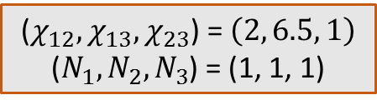
($χ_{12}, χ_{13}, χ_{23}$) = $\left(2, 6.5, 1\right)$
($N_{1}, N_{2}, N_{3}$) = (1, 1, 1)
Binodal line plotted by using 30 degree Taylor Series | Binodal line plotted by using exact logarithmic terms
Note: Number of obtained solutions for bimodal curve can be
increased if I run the code on a parallel machine.

Slide 7
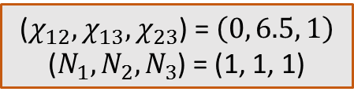
($χ_{12}, χ_{13}, χ_{23}$) = $\left(0, 6.5, 1\right)$
($N_{1}, N_{2}, N_{3}$) = (1, 1, 1)
Binodal line plotted by using 30 degree Taylor Series | Binodal line plotted by using exact logarithmic terms
Note: Number of obtained solutions for bimodal curve can be
increased if I run the code on a parallel machine.

Slide 8
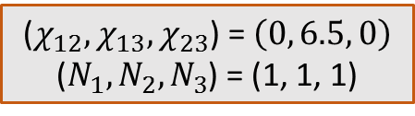
($χ_{12}, χ_{13}, χ_{23}$) = $\left(0, 6.5, 0\right)$
($N_{1}, N_{2}, N_{3}$) = (1, 1, 1)
Binodal line plotted by using 30 degree Taylor Series | Binodal line plotted by using exact logarithmic terms
Note: Number of obtained solutions for bimodal curve can be
increased if I run the code on a parallel machine.

Slide 9
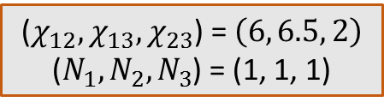
($χ_{12}, χ_{13}, χ_{23}$) = $\left(6, 6.5, 2\right)$
($N_{1}, N_{2}, N_{3}$) = (1, 1, 1)
Binodal line plotted by using 50 degree Taylor Series | Binodal line plotted by using exact logarithmic terms
Note: Number of obtained solutions for bimodal curve can be
increased if I run the code on a parallel machine.

Slide 10
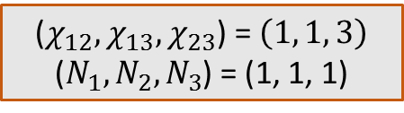
($χ_{12}, χ_{13}, χ_{23}$) = $\left(1, 1, 3\right)$
($N_{1}, N_{2}, N_{3}$) = (1, 1, 1)
Binodal line plotted by using 30 degree Taylor Series | Binodal line plotted by using exact logarithmic terms
Note: Number of obtained solutions for bimodal curve can be
increased if I run the code on a parallel machine.

Slide 11
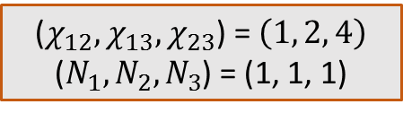
($χ_{12}, χ_{13}, χ_{23}$) = $\left(1, 2, 4\right)$
($N_{1}, N_{2}, N_{3}$) = (1, 1, 1)
Binodal line plotted by using 30 degree Taylor Series | Binodal line plotted by using exact logarithmic terms
Note: Number of obtained solutions for bimodal curve can be
increased if I run the code on a parallel machine.

Slide 12
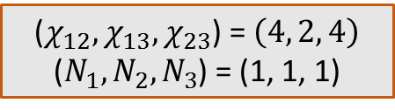
($χ_{12}, χ_{13}, χ_{23}$) = $\left(4, 2, 4\right)$
($N_{1}, N_{2}, N_{3}$) = (1, 1, 1)
Binodal line plotted by using 30 degree Taylor Series | Binodal line plotted by using exact logarithmic terms
Note: Number of obtained solutions for bimodal curve can be
increased if I run the code on a parallel machine.

Slide 13
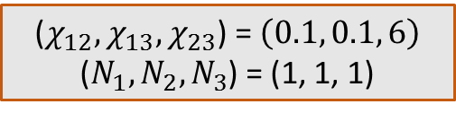
($χ_{12}, χ_{13}, χ_{23}$) = $\left(0.1, 0.1, 6\right)$
($N_{1}, N_{2}, N_{3}$) = (1, 1, 1)
Binodal line plotted by using 30 degree Taylor Series | Binodal line plotted by using exact logarithmic terms
Note: Number of obtained solutions for bimodal curve can be
increased if I run the code on a parallel machine.

Slide 14
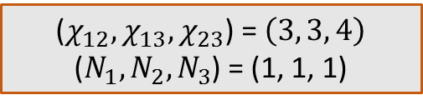
($χ_{12}, χ_{13}, χ_{23}$) = $\left(3, 3, 4\right)$
($N_{1}, N_{2}, N_{3}$) = (1, 1, 1)
Binodal line plotted by using 30 degree Taylor Series | Binodal line plotted by using exact logarithmic terms
Note: Number of obtained solutions for bimodal curve can be
increased if I run the code on a parallel machine.

Slide 15
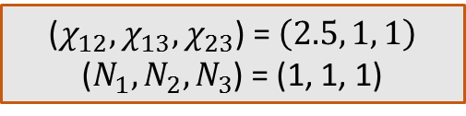
($χ_{12}, χ_{13}, χ_{23}$) = $\left(2.5, 1, 1\right)$
($N_{1}, N_{2}, N_{3}$) = (1, 1, 1)
Binodal line plotted by using 30 degree Taylor Series | Binodal line plotted by using exact logarithmic terms
Note: Number of obtained solutions for bimodal curve can be
increased if I run the code on a parallel machine.

